Slide 1
Pipelining -- Outline
Basic idea
Pipelined datapath
Pipelined control
Data hazards
Three methods to handle data hazards

Slide 2
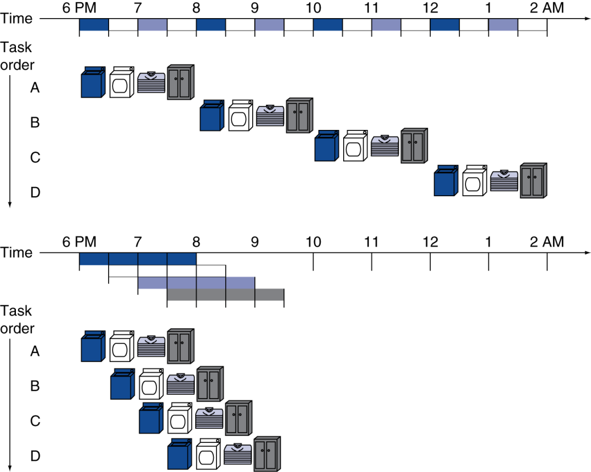
Pipelining Analogy
Pipelined laundry: overlapping execution
  Parallelism improves performance
§4.5 An Overview of Pipelining
Four loads:
  Speedup
  = 8/3.5 = 2.3
Non-stop:
  Speedup
  = 2n/0.5n + 1.5 ≈ 4
  = number of stages

Slide 3
Basic idea of pipeline
For single cycle computer, roughly, 5 steps
  IF, ID, EX, MEM, WB
For the current step, hardware for other steps are idle.
Use the idle hardware to work on other instructions
  Overlap the instruction executions.
  Add buffers to hold partial results of instruction execution

Slide 4
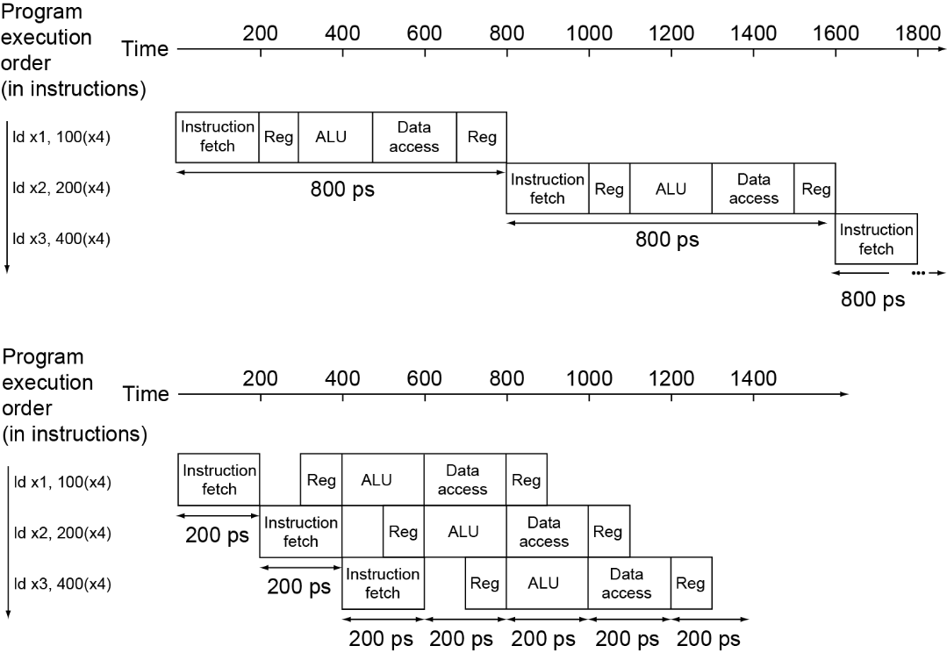
Pipeline Performance
Single-cycle (T_{c}= 800ps)
Pipelined (T_{c}= 200ps)

Slide 5
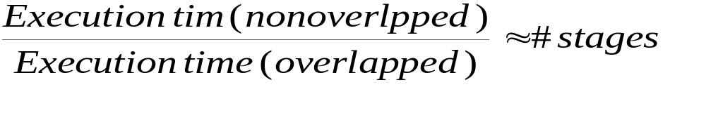
Pipelining: Basic Idea (con’t)
Pipeline: implementation technique in which multiple inst. are overlapped in execution
  Improve inst. throughput rather than inst. execution time
  speedup =
  pipe stage: balancing length of each stage with equal length, limited # pipe stages

Slide 6
RISC-V Pipe: 5 stages
IF: instruction fetch
ID: inst. decode and register fetch
EX: execution and effective address calculation
MEM: memory access
WB: write back to register
IF
ID
EX
MEM
WB

Slide 7
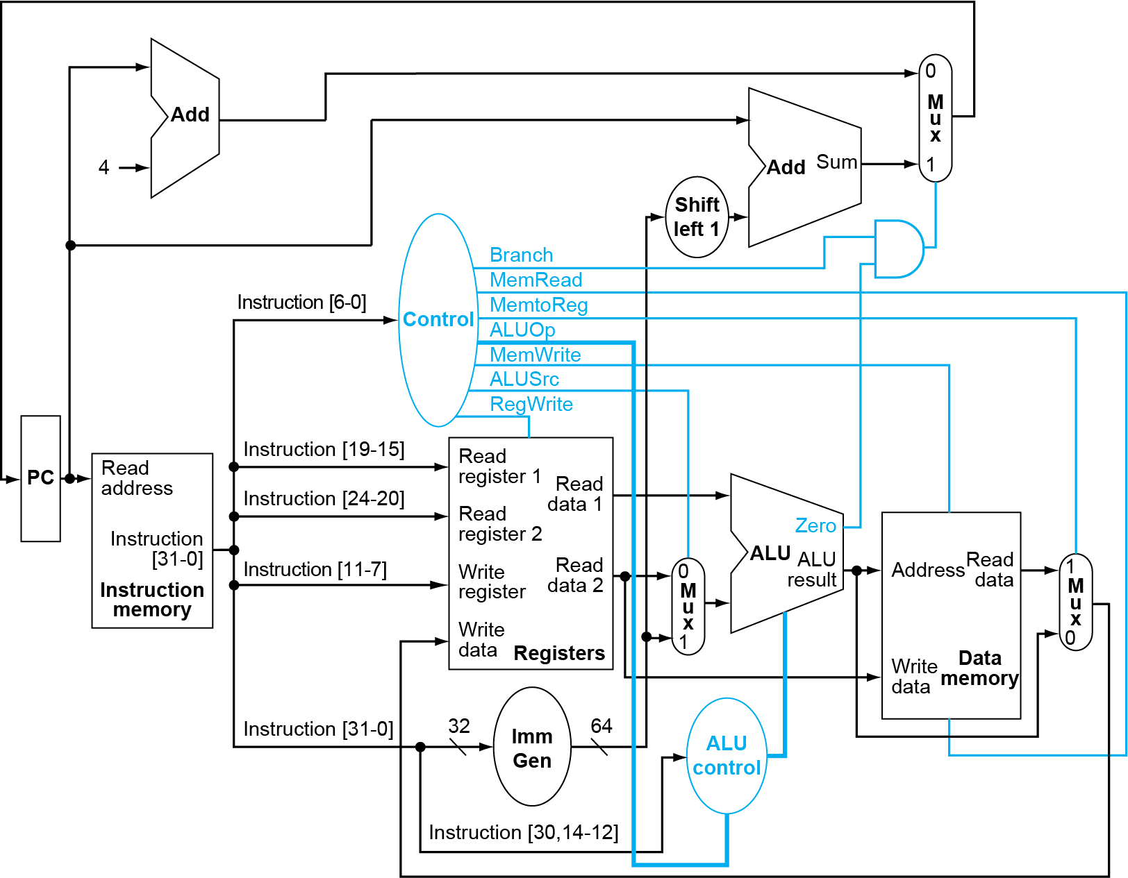
_{Gen}

Slide 8
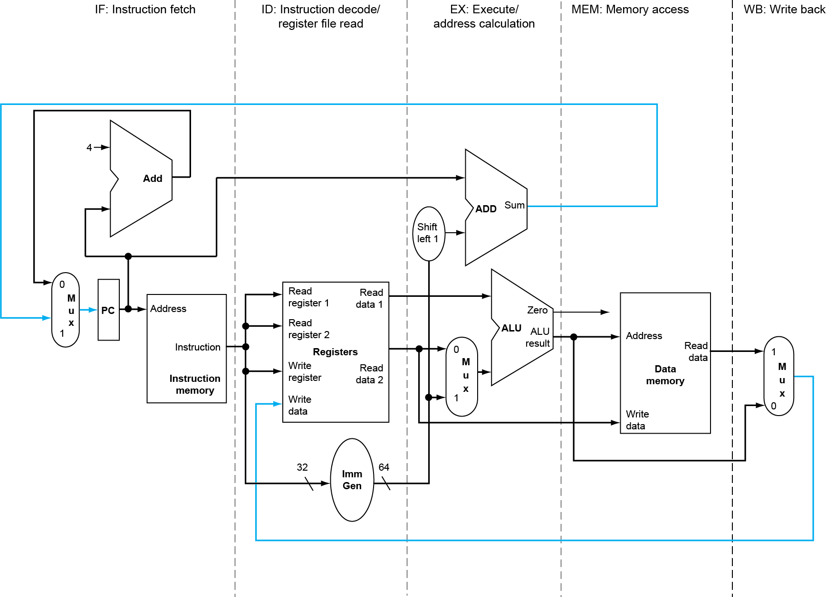
RISC-V Pipelined Datapath
§4.6 Pipelined Datapath and Control
WB
Chapter 4 — The Processor — <number>
Notes:
Morgan Kaufmann Publishers
Chapter 4 — The Processor

Slide 9
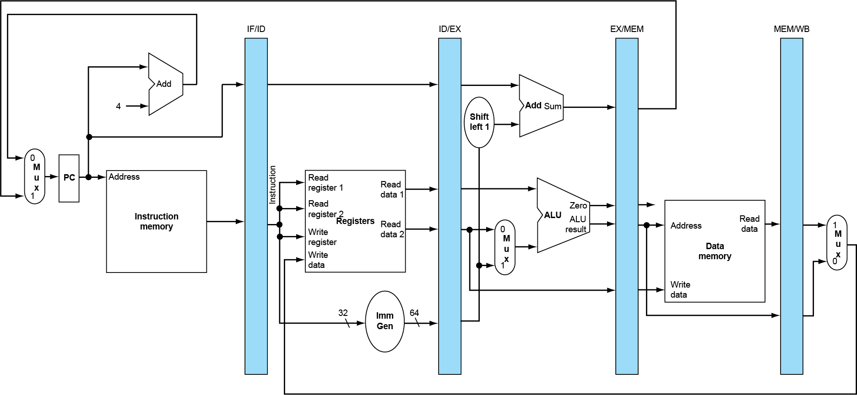
Pipeline registers
Need registers between stages
  To hold information produced in previous cycle
Notes:
Morgan Kaufmann Publishers
Chapter 4 — The Processor

Slide 10
Pipelining -- Control?

Slide 11
Pipeline control
We have 5 stages. What needs to be controlled in each stage?
  Instruction Fetch and PC Increment
  Instruction Decode / Register Fetch
  Execution
  Memory Stage
  Write Back
Generate all control signals in the ID stage and pipeline them

Slide 12
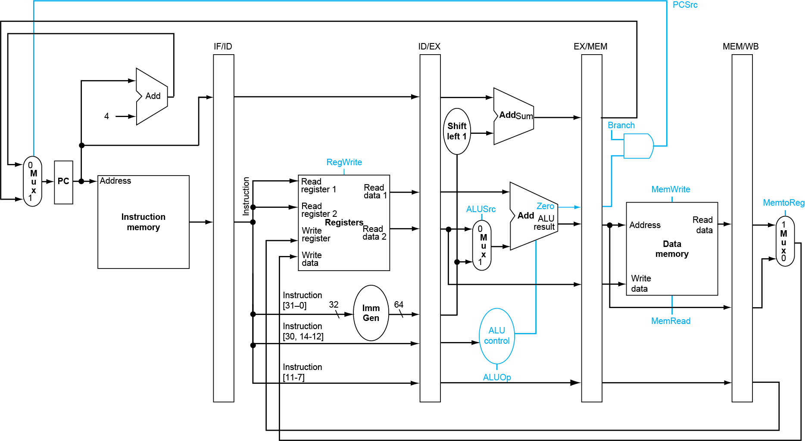
Pipelined Control (Simplified)
Chapter 4 — The Processor — <number>
Notes:
Morgan Kaufmann Publishers
Chapter 4 — The Processor

Slide 13
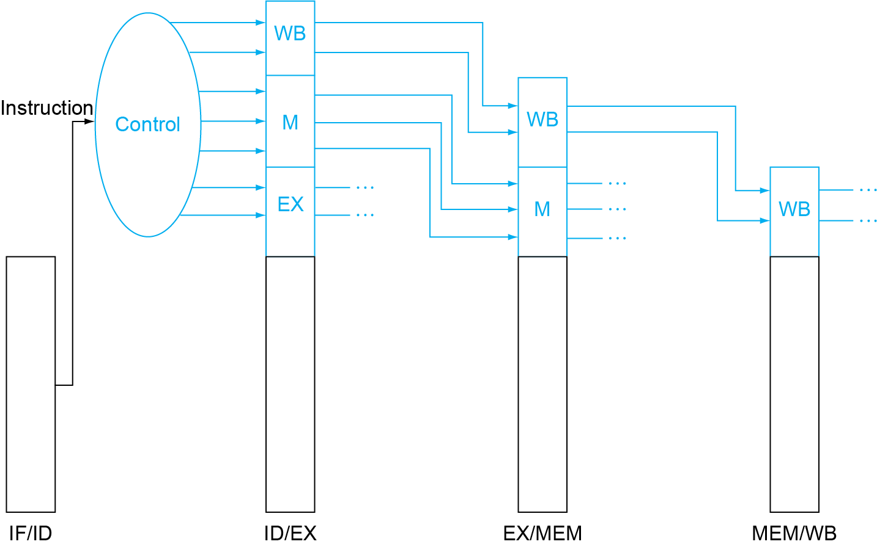
Pipelined Control
Control signals derived from instruction
  as in single-cycle implementation
  passed along just like the data
Chapter 4 — The Processor — <number>
Notes:
Morgan Kaufmann Publishers
Chapter 4 — The Processor

Slide 14
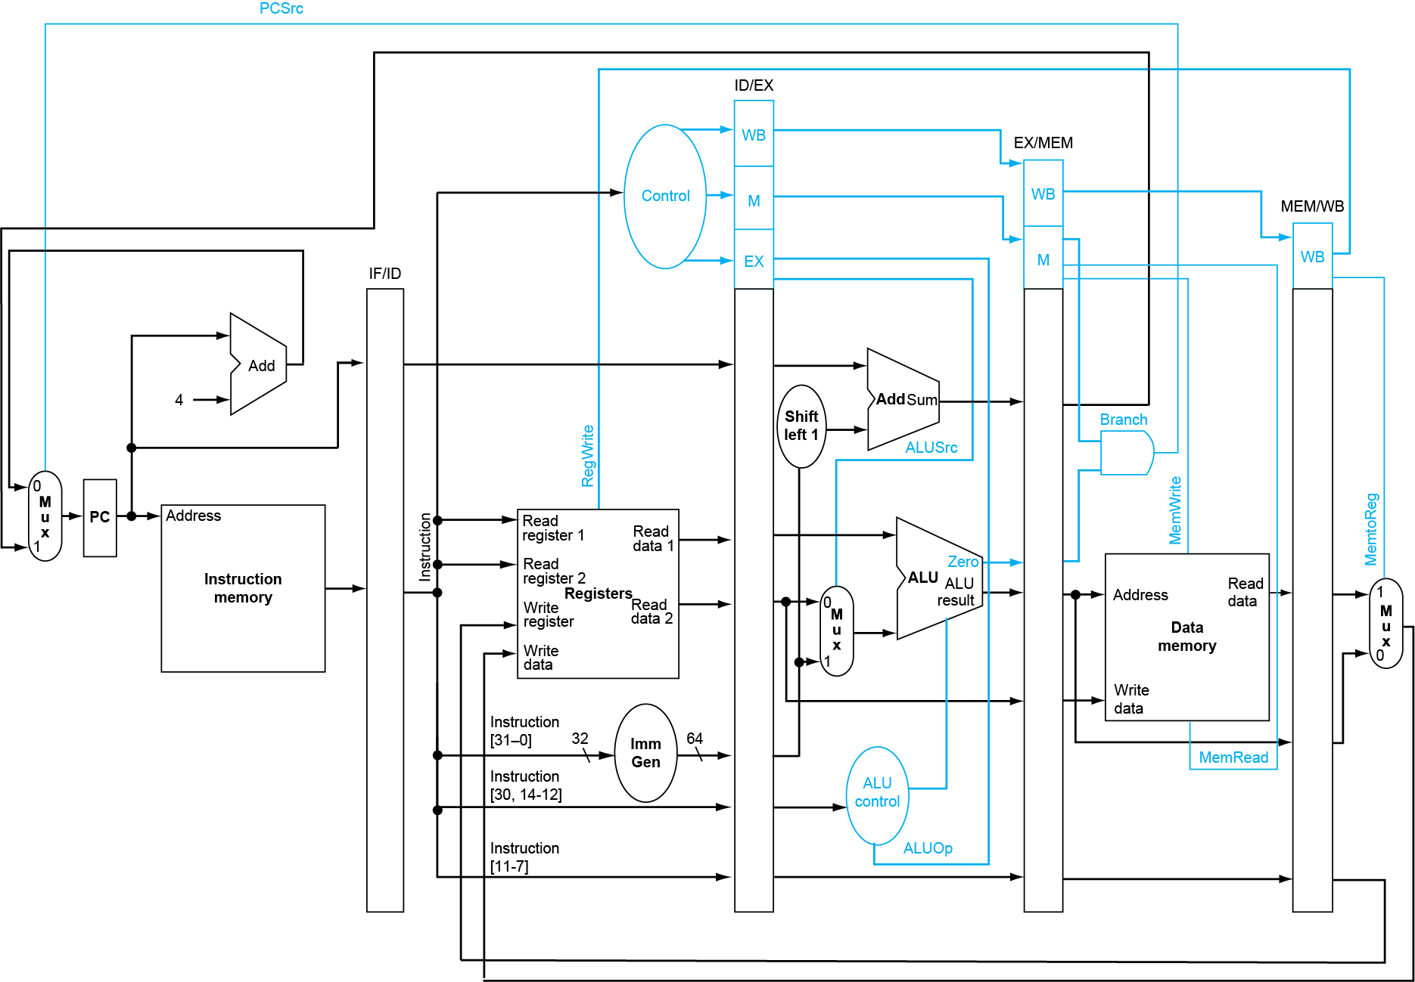
Pipelined Control
Chapter 4 — The Processor — <number>
Notes:
Morgan Kaufmann Publishers
Chapter 4 — The Processor

Slide 15

Example: How add x4, x2, x3 pass the Pipe

Slide 16
_{Cycle 1}

Slide 21
Performance
Execution time of execution n load word instructions
Speedup
CPI
Size of each pipeline buffer:
  IF/ID
  ID/EX
  EX/MEM
  MEM/WB

Slide 22
Example: How the five instructions go through the pipe, and what are the register values
Determine the values of every field in 4 pipeline registers in cycle 5 for instructions
ld x10, 24(x1)
sub x11, x2, x3
and x12, x4, x5
or x13, x6, x7
add x14, x8, x9
Initial value of PC: 512
Initial values of registers
8+ register number*4
Initial values of memory cells
1000+memory address
Assume register
  MEM/WB contains info
    “ld x10, 24(x1)”
  EX/MEM: sub x11, x2, x3
  ID/EX: and x12, x4, x5
  IF/ID: or x13, x6, x7

Slide 24
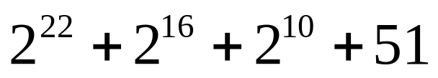
Construct the 5 instructions from a given state
Stage 5: Regwrt MemtoReg = 11, WrtAddr=16
Stage 4: WB=00, M=100, WrtAddr=31
Stage 3: WB=00, M=001, EX=001,x5, x6, imm gen =16, WrtAddr=6
Stage 2: WB=10, M=000 EX=100, rs1=2, rs2=4, inst[31:0]=

Slide 25
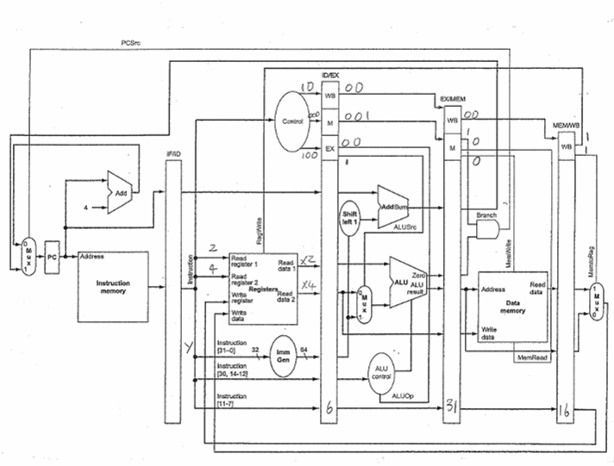

Slide 27
Graphically Representing Pipelines
Can help with answering questions like:
  how many cycles does it take to execute this code?
  what is the ALU doing during cycle 4?
  use this representation to help understand datapaths
T
i
m
e
(
i
n
c
l
o
c
k
c
y
c
l
e
s
)
P
r
o
g
r
a
m
C
C
1
C
C
2
C
C
3
C
C
4
C
C
5
C
C
6
e
x
e
c
u
t
i
o
n
o
r
d
e
r
(
i
n
i
n
s
t
r
u
c
t
i
o
n
s
)
l
d
x
1
0
,
2
0
(x
1
)
I
M
R
e
g
A
L
U
D
M
R
e
g
s
u
b
x
1
1
,
x
2
,
x
3
I
M
R
e
g
A
L
U
D
M
R
e
g

Slide 28
Pipeline Hazards
Structural hazards -- caused by hardware resource conflicts
Data hazards -- caused by data dependence
Control hazards -- caused by branch / jump instructions

Slide 29
Structure Hazards
Conflict for use of a resource
In RISC-V pipeline with a single memory
  Load/store requires data access
  Instruction fetch would have to stall for that cycle
    Would cause a pipeline “bubble”
Hence, pipelined datapaths require separate instruction/data memories
  Or separate instruction/data caches

Slide 30
Data Dependence => Data Hazards
sub x2, x1, x3 I1
and x12, x2, x5 I2
or x13, x6, x2 I3
add x14, x2, x2 I4
sd x15, 100(x2) I5
add x2, x4, x5 I6
Read after write dependence (RAW)
Write after read dependence (WAR)
Write after write dependence (WAW)
Data dependence does not cause any problem in non overlapped execution
Howa bout pipeline?
Data dependence: A relation between 2 instructions that reference same register and one is write and no other write between.

Slide 31
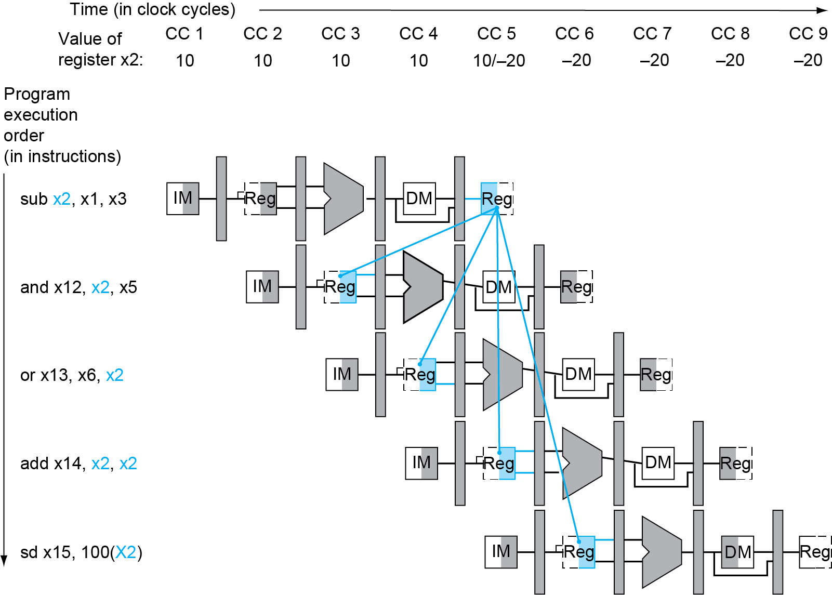
Data Hazards
Notes:
Morgan Kaufmann Publishers
Chapter 4 — The Processor

Slide 32
Data Hazard
I4 is ok when register write happens when clock is high & register read happens when clock is low
Need additional two cycles to resolve hazard.
  CPI = 3 when hazards
How about WAW and WAR
  They to not cause hazards in our pipeline.

Slide 33
How to Handle Data Dependence?
Compiler approach
  insert dummy operations or “nops”
  reschedule instructions
Hardware approach
  forwarding

Slide 34
Compiler Approach 1 for Data Hazards
Compiler generates code without data hazards by inserting dummy operations
sub x2, x1, x3
and x12, x2, x5
or x13, x6, x2
add x14, x2, x2
sd x15, 100(x2)
This code has data hazards, not allowed
Insert dummy operations “nop”
Problem: this really slows us down!

Slide 35
Compiler Approach 2-- Scheduling
Move independent inst. around to eliminate data hazards and fill in bubbles
I1 and x18, x9, x10
I2 sub x2, x1, x3
I3 and x12, x2, x5
I4 or x13, x6, x2
I5 add x14, x2, x2
I6 sd x15, 100(x2)
I7 sub x16, x7, x8
I8 add x17, x8, x9
RAW dependence b/w I2 and I3, I4, I5, I6

Slide 36
How to identify all dependence
Find all instructions that write registers
For each such instruction writing register xj, identify all other instructions that either read or write register xj
Data dependence graph (DDG)

Slide 37
Forwarding
Notes:
Morgan Kaufmann Publishers
Chapter 4 — The Processor

Slide 40
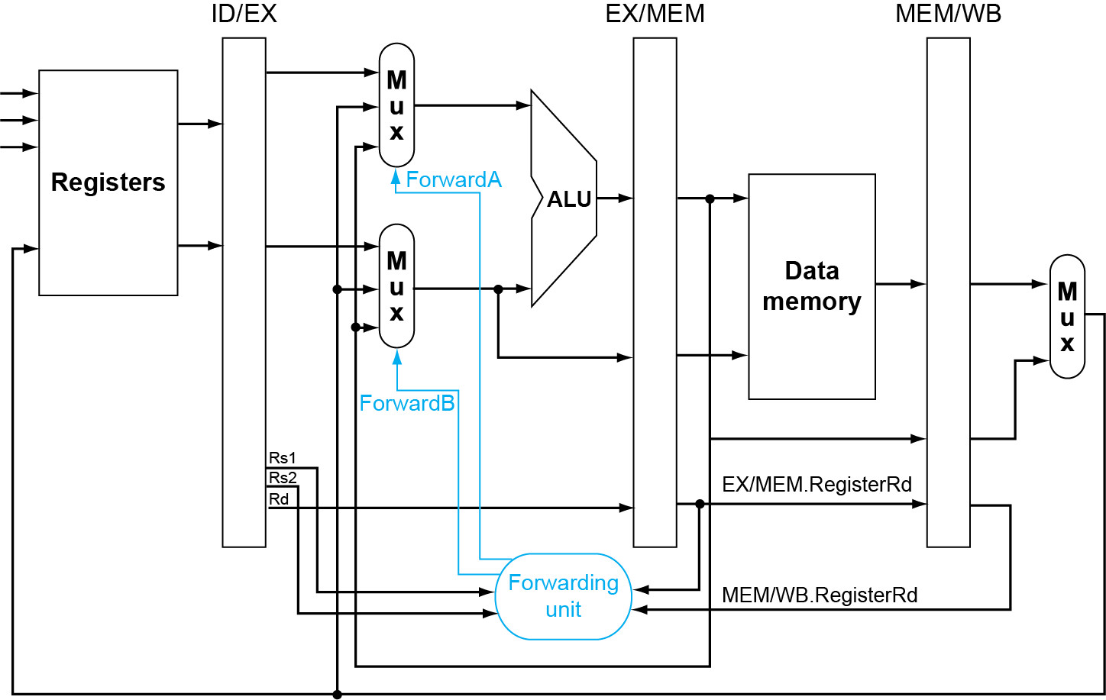
Forwarding Paths
Notes:
Morgan Kaufmann Publishers
Chapter 4 — The Processor

Slide 41
Detecting the Need to Forward
Pass rs1, rs2 along pipeline
  e.g., ID/EX.RegisterRs1 = register number for Rs1 sitting in ID/EX pipeline register
ALU operand register numbers in EX stage are given by
  ID/EX.RegisterRs1, ID/EX.RegisterRs2
Data hazards when
  1a. EX/MEM.RegisterRd = ID/EX.RegisterRs1
  1b. EX/MEM.RegisterRd = ID/EX.RegisterRs2
  2a. MEM/WB.RegisterRd = ID/EX.RegisterRs1
  2b. MEM/WB.RegisterRd = ID/EX.RegisterRs2
Fwd from
EX/MEM
pipeline reg
Fwd from
MEM/WB
pipeline reg
Notes:
Morgan Kaufmann Publishers
Chapter 4 — The Processor

Slide 42
Detecting the Need to Forward
But only if forwarding instruction will write to a register!
  EX/MEM.RegWrite, MEM/WB.RegWrite
And only if Rd for that instruction is not 0
  EX/MEM.RegisterRd ≠ 0,
  MEM/WB.RegisterRd ≠ 0
Notes:
Morgan Kaufmann Publishers
Chapter 4 — The Processor

Slide 43
Forwarding Conditions
Mux control | Source | Explanation
ForwardA = 00 | ID/EX | The first ALU operand comes from the register file.
ForwardA = 10 | EX/MEM | The first ALU operand is forwarded from the prior ALU result.
ForwardA = 01 | MEM/WB | The first ALU operand is forwarded from data memory or an earlier ALU result.
ForwardB = 00 | ID/EX | The second ALU operand comes from the register file.
ForwardB = 10 | EX/MEM | The second ALU operand is forwarded from the prior ALU result.
ForwardB = 01 | MEM/WB | The second ALU operand is forwarded from data memory or an earlier ALU result.
Notes:
Morgan Kaufmann Publishers
Chapter 4 — The Processor

Slide 44
A Bug: Double Data Hazard
Consider the sequence:
  add x1,x1,x2
  add x1,x1,x3
  add x1,x1,x4
Both hazards occur
  Want to use the most recent
Revise MEM hazard condition
  Only fwd if EX hazard condition isn’t true
Notes:
Morgan Kaufmann Publishers
Chapter 4 — The Processor

Slide 45
Revised Forwarding Condition
MEM hazard
  if (MEM/WB.RegWrite
  and (MEM/WB.RegisterRd ≠ 0)
  and not(EX/MEM.RegWrite and (EX/MEM.RegisterRd ≠ 0)
  and (EX/MEM.RegisterRd ≠ ID/EX.RegisterRs1))
  and (MEM/WB.RegisterRd = ID/EX.RegisterRs1)) ForwardA = 01
  if (MEM/WB.RegWrite
  and (MEM/WB.RegisterRd ≠ 0)
  and not(EX/MEM.RegWrite and (EX/MEM.RegisterRd ≠ 0)
  and (EX/MEM.RegisterRd ≠ ID/EX.RegisterRs2))
  and (MEM/WB.RegisterRd = ID/EX.RegisterRs2)) ForwardB = 01
Notes:
Morgan Kaufmann Publishers
Chapter 4 — The Processor

Slide 46
Forwarding--con’t
Example: cycle 5
  I1 sub $2, $1, $3
  I2 and $12, $2, $5
  I3 or $13, $6, $2
  …

Slide 47
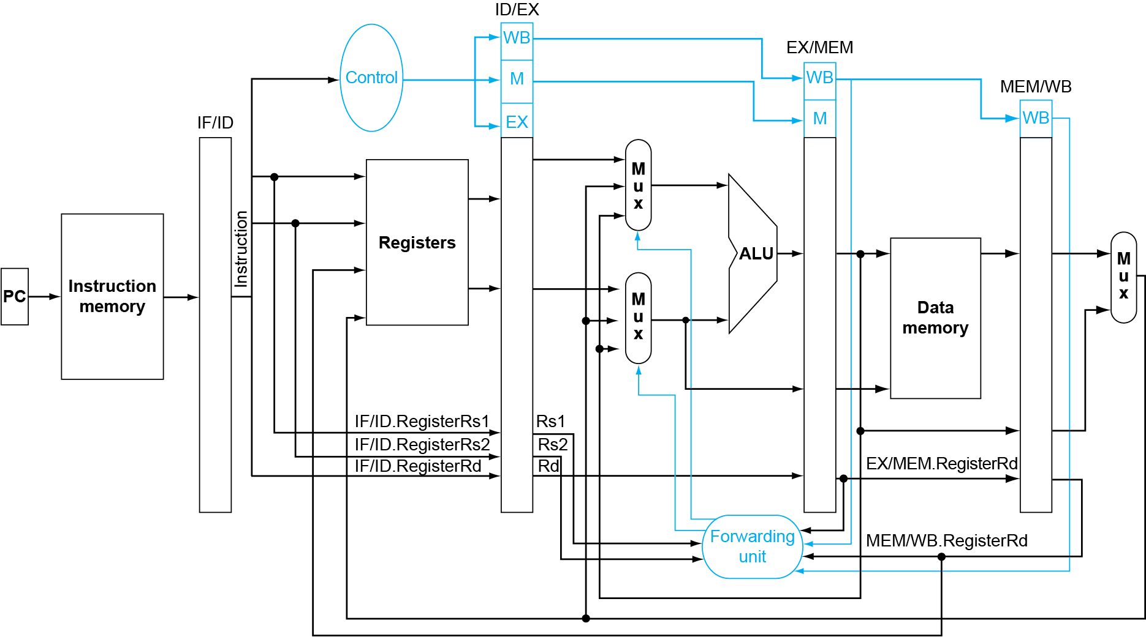
Datapath with Forwarding
Notes:
Morgan Kaufmann Publishers
Chapter 4 — The Processor

Slide 48
Forwarding Unit--Summary
Compares the 2 read addresses of instruction in EX with write addresses of instructions in MEM and WB
Input
  rs1 and rs2 in ID/EX
  write address (rd ) and RegWrt in EX/MEM
  write address (rd) and RegWrt in MEM/WB
  check WAW
  check if rd=0?
Output
  ForwardA to control the top mux before ALU
  ForwardB to control the bottom mux before ALU

Slide 49
Load-use hazard, can't always forward
A read after a ld write to the same register.
  Need a hazard detection unit to “stall” the load instruction
T
i
m
e
(
i
n
c
l
o
c
k
c
y
c
l
e
s
)
P
r
o
g
r
a
m
C
C
1
C
C
2
C
C
3
C
C
4
C
C
5
C
C
6
C
C
7
C
C
8
C
C
9
e
x
e
c
u
t
i
o
n
o
r
d
e
r
(
i
n
i
n
s
t
r
u
c
t
i
o
n
s
)
d
R
e
g
l
x
2
,
2
0
(
x
1
)
I
M
D
M
R
e
g
a
n
d
x
4
,
x
2
,
x
5
I
M
R
e
g
D
M
R
e
g
o
r
x
8
,
x
2
,
x
6
I
M
R
e
g
D
M
R
e
g
a
d
d
x
9
,
x
4
,
x
2
I
M
R
e
g
D
M
R
e
g
or
x
1
,
x
6
,
x
7
I
M
R
e
g
D
M
R
e
g

Slide 50
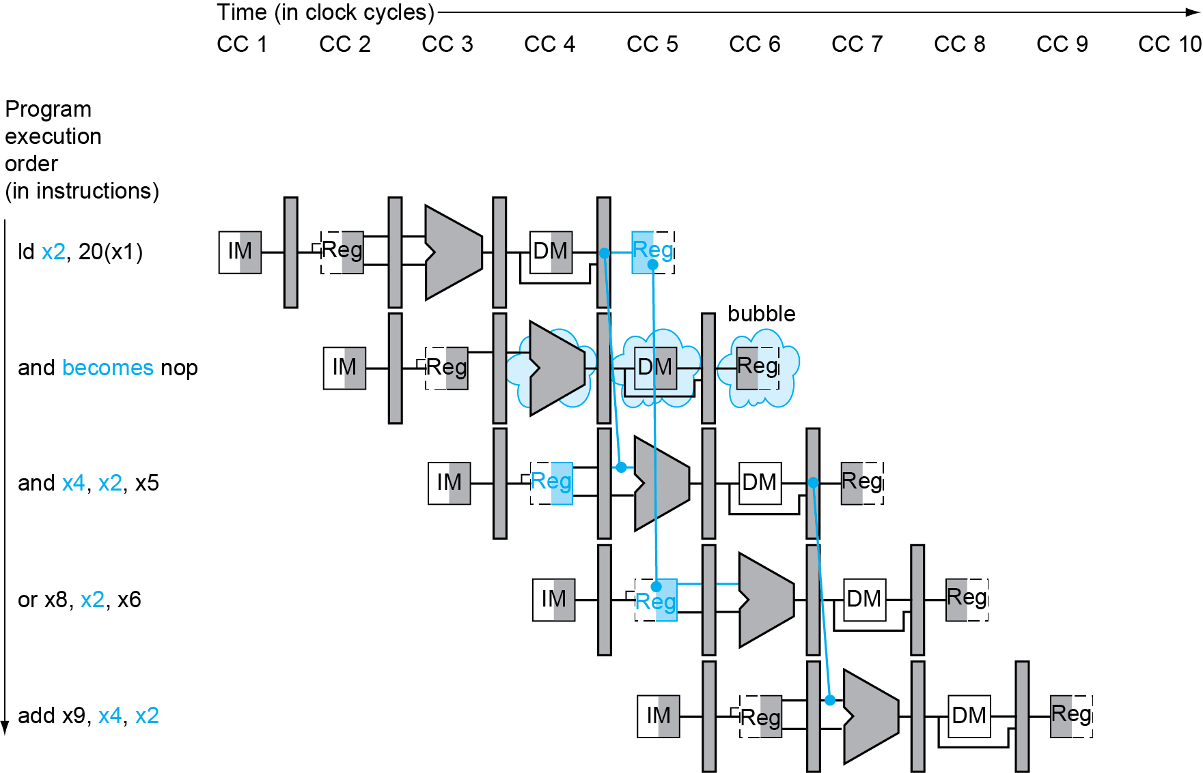
Load-Use Data Hazard
Stall inserted here
Notes:
Morgan Kaufmann Publishers
Chapter 4 — The Processor

Slide 51
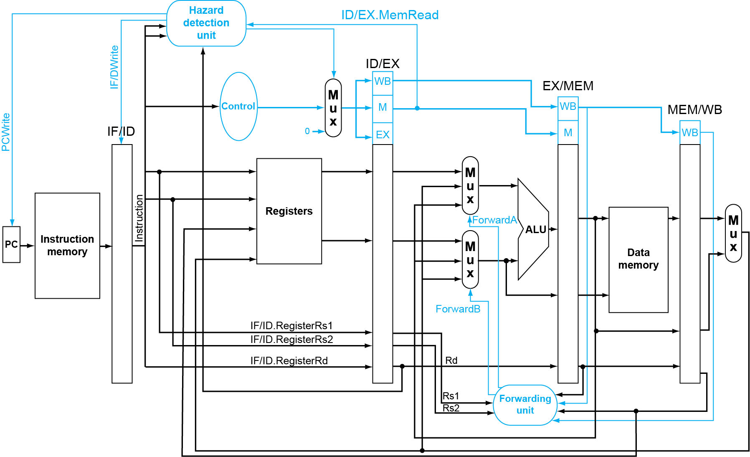
Datapath with Hazard Detection
Notes:
Morgan Kaufmann Publishers
Chapter 4 — The Processor

Slide 52
Load-Use Hazard Detection
Check when using instruction is decoded in ID stage
ALU operand register numbers in ID stage are given by
  IF/ID.RegisterRs1, IF/ID.RegisterRs2
Load-use hazard when
  ID/EX.MemRead and
  ((ID/EX.RegisterRd = IF/ID.RegisterRs1) or
  (ID/EX.RegisterRd = IF/ID.RegisterRs1))
If detected, stall and insert bubble
Notes:
Morgan Kaufmann Publishers
Chapter 4 — The Processor

Slide 53
How to Stall the Pipeline
Force control values in ID/EX register to 0
  EX, MEM and WB do nop (no-operation)
Prevent update of PC and IF/ID register
  Using instruction is decoded again
  Following instruction is fetched again
  1-cycle stall allows MEM to read data for ld
    Can subsequently forward to EX stage
Notes:
Morgan Kaufmann Publishers
Chapter 4 — The Processor

Slide 54
Stalls and Performance
The BIG Picture
Stalls reduce performance
  But are required to get correct results
Compiler can arrange code to avoid hazards and stalls
  Requires knowledge of the pipeline structure
Notes:
Morgan Kaufmann Publishers
Chapter 4 — The Processor

Slide 55
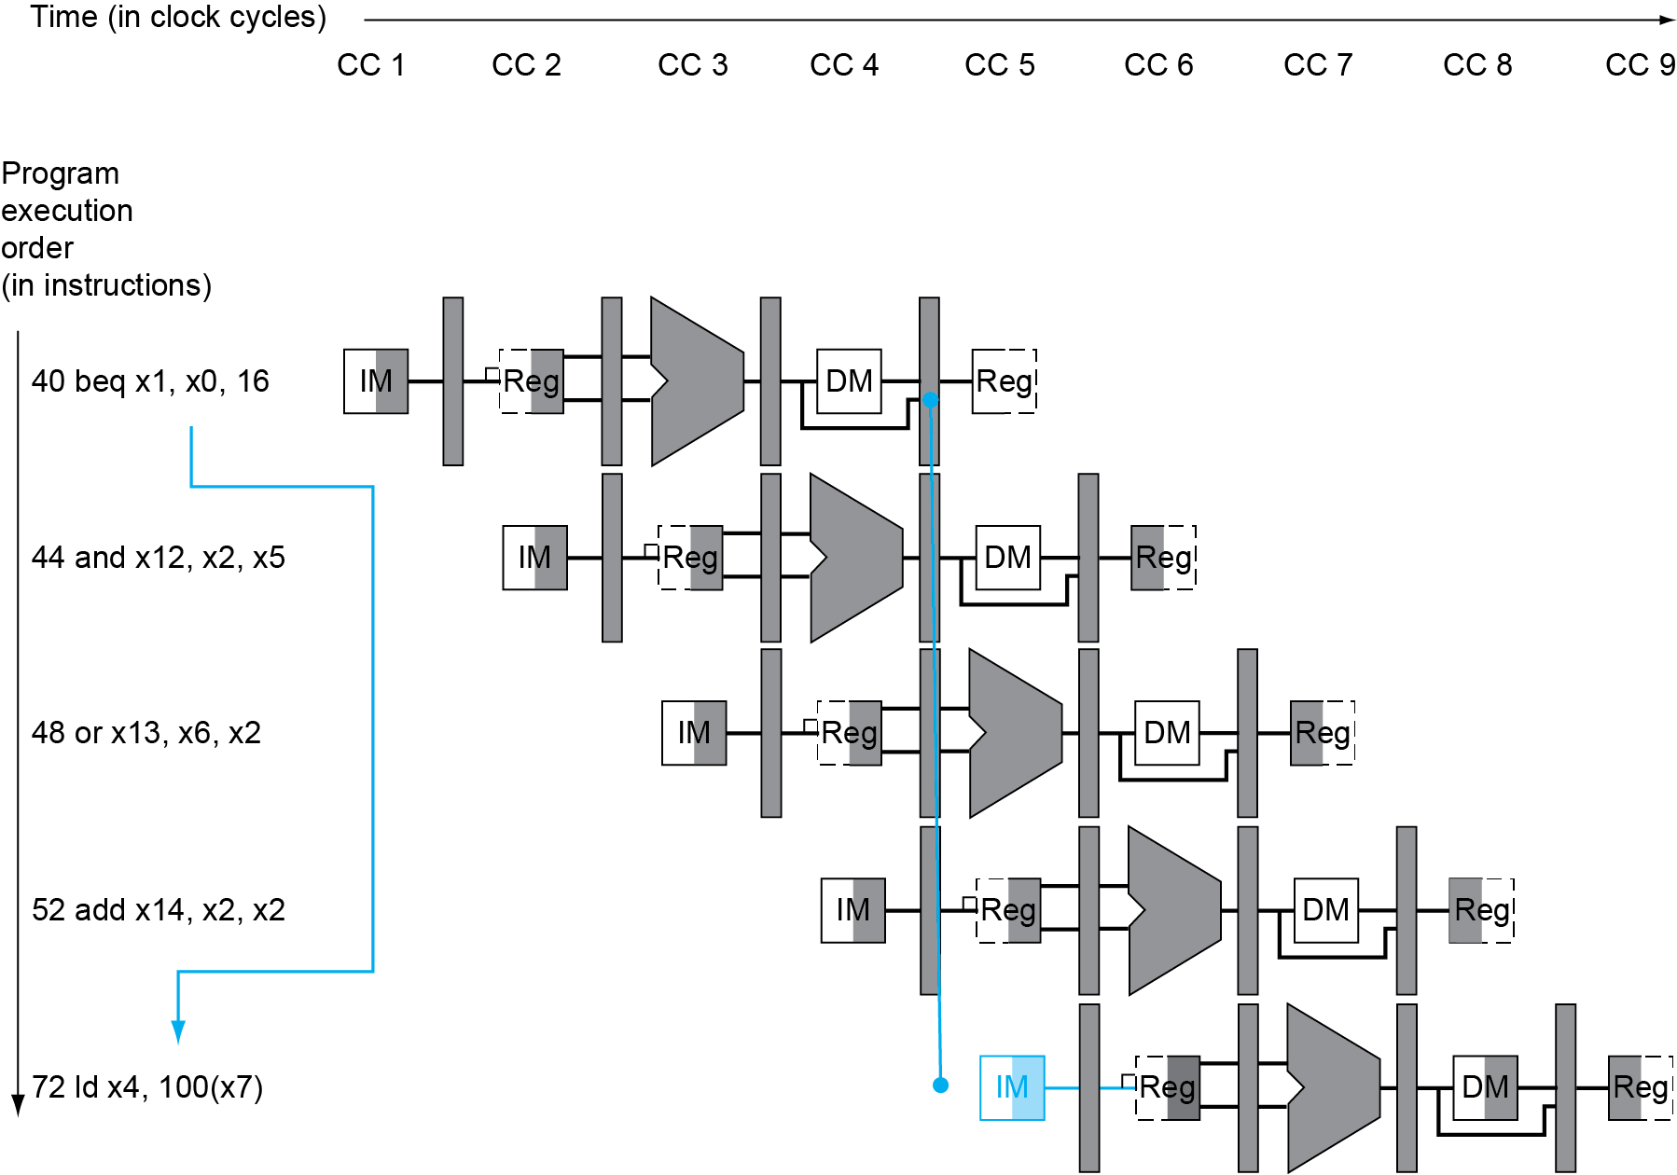
Branch Hazards
If branch outcome determined in MEM
Flush these
instructions
(Set control
values to 0)
PC
Notes:
Morgan Kaufmann Publishers
Chapter 4 — The Processor

Slide 56
Control Hazards--How to handle?
One software scheme: branch delay slot
  Compiler inserts an instruction directly after a branch instruction that is independent of the branch inst.
    No mater the branch is taken or not, that instruction should always be executed.
One optimization
  move branch addr calculation and condition test to ID stage
    The lost 3 cycles is cut to 1.

Slide 57
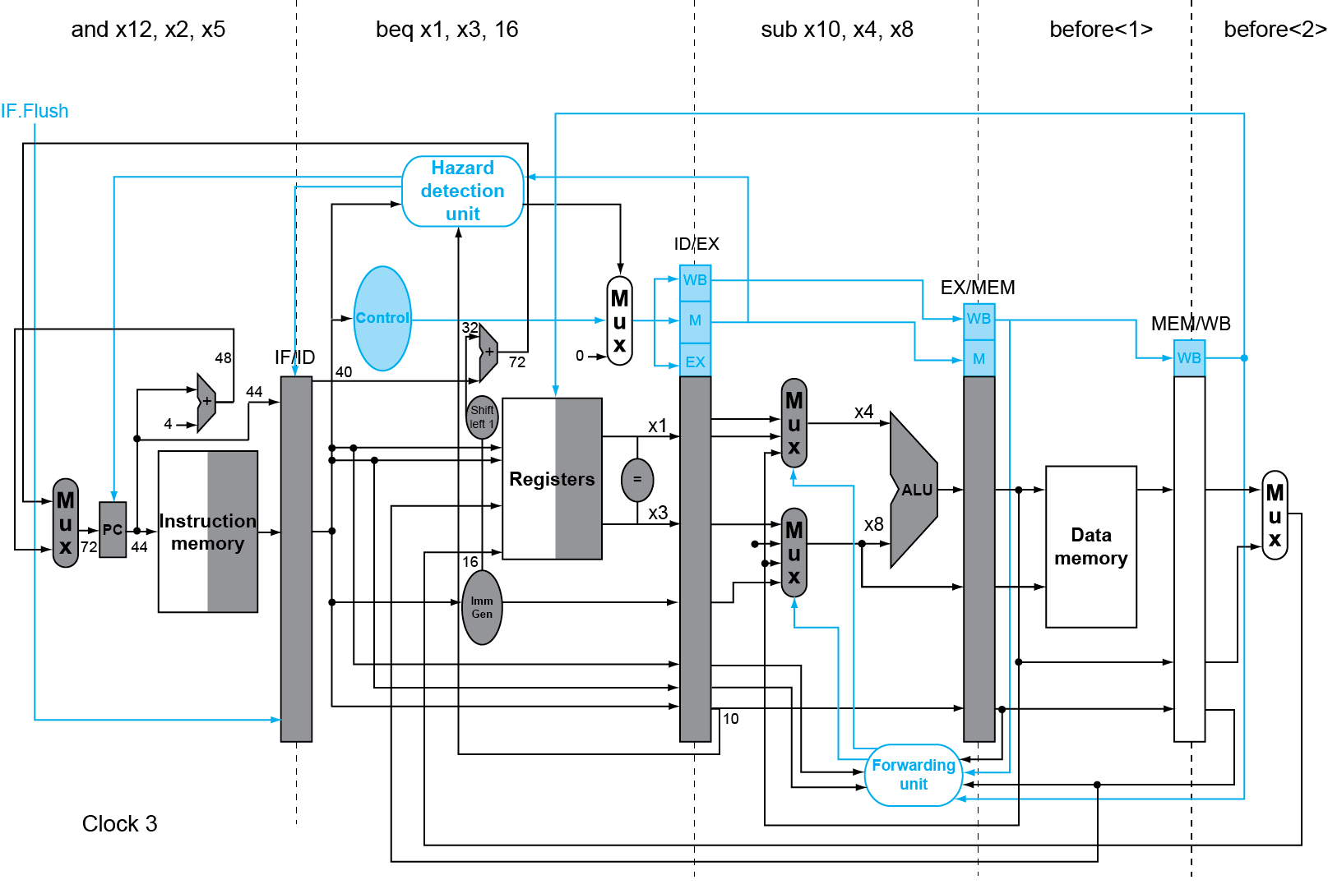
Notes:
Morgan Kaufmann Publishers
Chapter 4 — The Processor

Slide 58

Flushing instructions
Move branch addr. calculation/condition testing to stage 2 (ID)
Condition testing: use 32 XOR gates to compare bitwisely
  delay: negligible
IF.Flush==branch control line in single cycle datapath
is used to control write of PC & IF.ID buffer
If F=1, take branch by doing two operations
  zero IF.ID buffer (flushing)
  write PC with branch address
If branch taken, lose one cycle
CPI of beq

Slide 59
Reducing Branch Delay
Example: branch taken
  36: sub x10, x4, x8
  40: beq x1, x3, 16 // PC-relative branch
  // to 40+16*2=72
  44: and x12, x2, x5
  48: orr x13, x2, x6
  52: add x14, x4, x2
  56: sub x15, x6, x7
  ...
  72: ld x4, 50(x7)
Notes:
Morgan Kaufmann Publishers
Chapter 4 — The Processor

Slide 60
Example: Branch Taken
Notes:
Morgan Kaufmann Publishers
Chapter 4 — The Processor

Slide 61
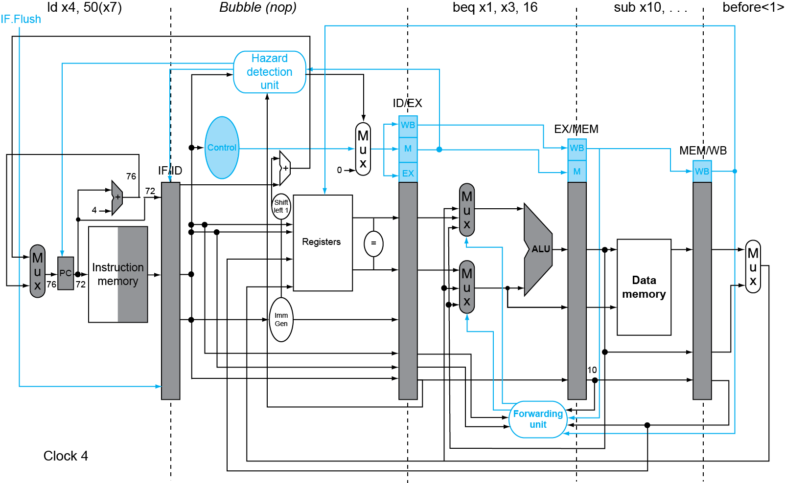
Example: Branch Taken
Notes:
Morgan Kaufmann Publishers
Chapter 4 — The Processor

Slide 62
Dynamic Branch Prediction
In deeper and superscalar pipelines, branch penalty is more significant
Use dynamic prediction
  Branch prediction buffer (aka branch history table)
  Indexed by recent branch instruction addresses
  Stores outcome (taken/not taken)
  To execute a branch
    Check table, expect the same outcome
    Start fetching from fall-through or target
    If wrong, flush pipeline and flip prediction
Chapter 4 — The Processor — <number>
Notes:
Morgan Kaufmann Publishers
Chapter 4 — The Processor

Slide 63
Exceptions and Interrupts
§4.9 Exceptions
“Unexpected” events requiring change
in flow of control
  Different ISAs use the terms differently
Exception
  Arises within the CPU
    e.g., undefined opcode, syscall, …
Interrupt
  From an external I/O controller
Dealing with them without sacrificing performance is hard
Chapter 4 — The Processor — <number>
Notes:
Morgan Kaufmann Publishers
Chapter 4 — The Processor

Slide 64
Handling Exceptions
Save PC of offending (or interrupted) instruction
  In RISC-V: Supervisor Exception Program Counter (SEPC)
Save indication of the problem
  In RISC-V: Supervisor Exception Cause Register (SCAUSE)
  64 bits, but most bits unused
    Exception code field: 2 for undefined opcode, 12 for hardware malfunction, …
Jump to handler
  Assume at 0000 0000 1C09 0000_{hex}
Chapter 4 — The Processor — <number>
Notes:
Morgan Kaufmann Publishers
Chapter 4 — The Processor

Slide 65
Performance Analysis-- Individual CPI
Basic Pipeline
Instruction | R | ld | sd
CPI/no dependence
CPI/with dependence*
Instruction | beq | jal
CPI (branch is not taken)
CPI (branch is taken)

Slide 66
Performance Analysis-- Individual CPI
Advanced Pipeline
Instruction | R | ld | sd
CPI/no dependence
CPI/with dependence*
Instruction | beq | jal
CPI (branch is not taken)
CPI (branch is taken)

Slide 67
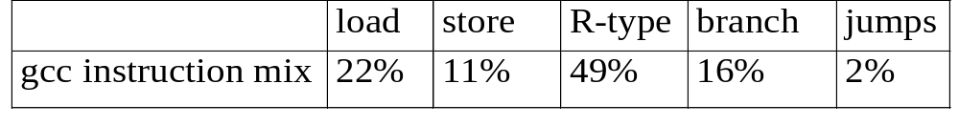
Calculating CPI of our Pipeline
CPI when there is no any hazard in the pipeline
Assume: half of ld are immediately followed by a dependent instruction; 75% of branches are taken; jal is treated as a taken branch inst, 30% R type instructions have dependence with their following instructions.
CPI of the basic pipeline
CPI of the advanced pipeline

Slide 68
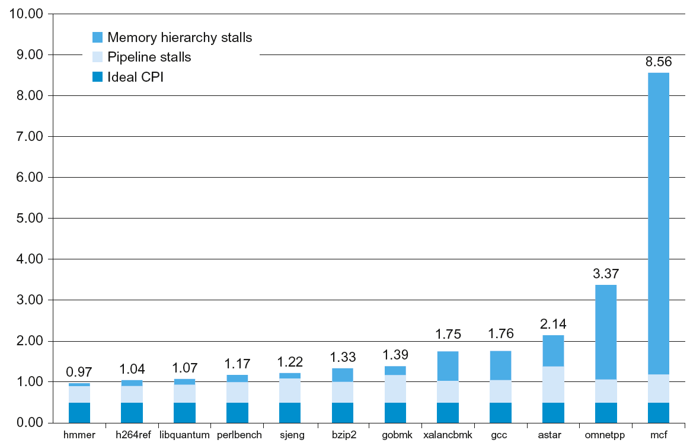
ARM Cortex-A53 Performance

Slide 69
Improving Performance
Dynamic Pipeline Scheduling
  Hardware chooses which instructions to execute next
  Will execute instructions out of order (e.g., doesn’t wait for a dependency to be resolved, but rather keeps going!)
  Speculates on branches and keeps the pipeline full
  (may need to rollback if prediction incorrect)
Trying to exploit instruction-level parallelism

Slide 70
Advanced Pipelining
Increase the depth of the pipeline
Start more than one instruction each cycle (multiple issue)
Loop unrolling to expose more ILP (better scheduling)
“Superscalar” processors
  DEC Alpha 21264: 9 stage pipeline, 6 instruction issue
All modern processors are superscalar and issue multiple instructions usually with some limitations (e.g., different “pipes”)
VLIW: very long instruction word, static multiple issue
(relies more on compiler technology)

Slide 71
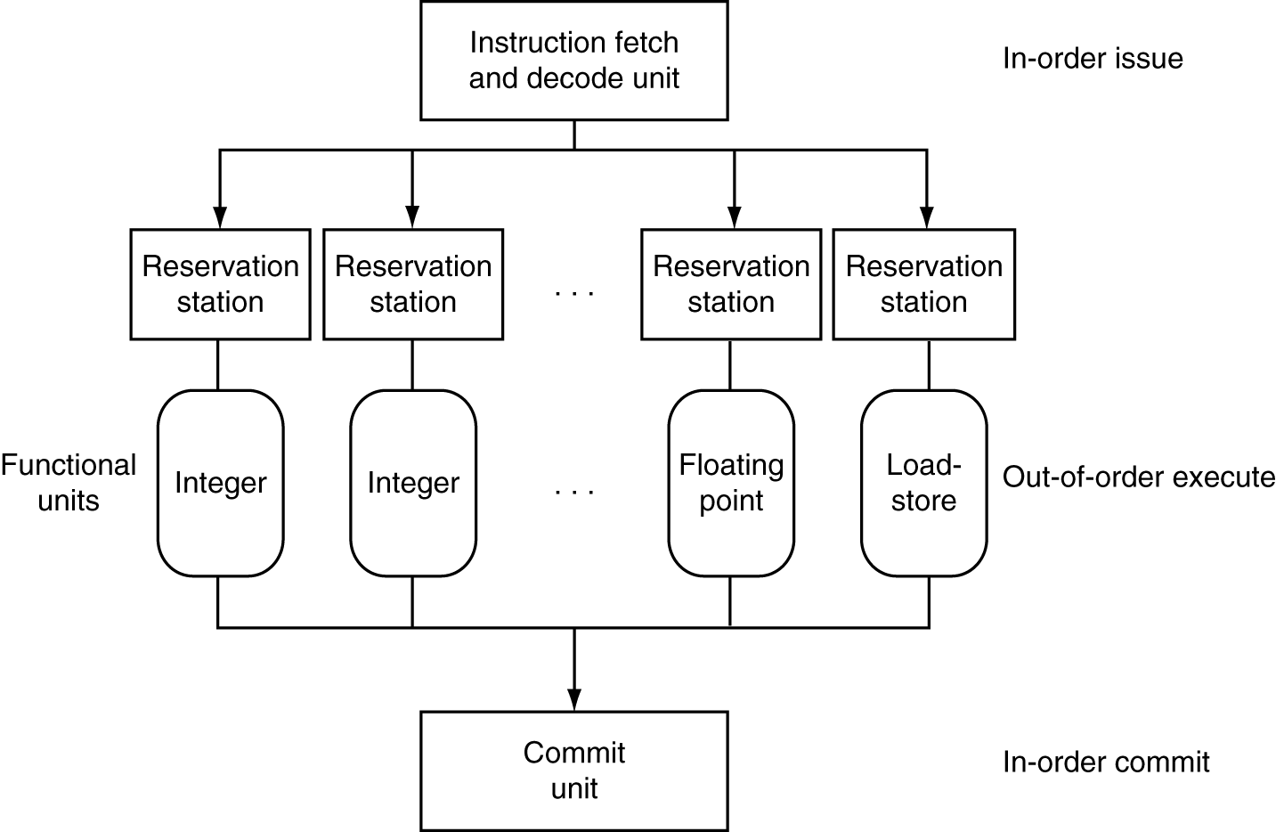
Dynamically Scheduled CPU
Preserves dependencies
Hold pending operands
Results also sent to any waiting reservation stations
Reorders buffer for register writes
Can supply operands for issued instructions

Slide 72
Example
Considering the following loop
mov x5, x0
SUM: ld x10, 1000(x20)
add x5, x5, x10
addi x20, x20, -4
bne x20, x0, SUM
Assume a pipeline without forwarding and hazard detection
Question (1) how to reorder inst and insert as few as needed nop to eliminate hazards?
(2) find #cycles = f (N: #words added)

Slide 73
Loop Unrolling
Replicate loop body to expose more parallelism
  Reduces loop-control overhead
Example enroll by 2, and 3
Notes:
Morgan Kaufmann Publishers
Chapter 4 — The Processor

Slide 74
Concluding Remarks
ISA influences design of datapath and control
Pipelining improves instruction throughput
using parallelism
  More instructions completed per second
  Latency for each instruction not reduced
Hazards: structural, data, control

